Slide 1
High-Performance Graphics 2024
26-28 July 2024
Denver, CO

Slide 2
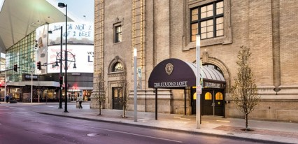
Welcome to HPG 2024
We are in-person in the US again
Live streaming on YouTube
  2020 – 2023 talk recordings on YouTube
  Almost 137,000 views
The Studio Loft
  Top floor of the Ellie Caulkins Opera House
  Private entrance on 14th & Champa streets
  Part of the Denver Performing Arts Complex
The Studio Loft
Denver Performing Arts Complex

Slide 3
Where We’ve Been
SIGGRAPH/Eurographics
Graphics Hardware
1986
SIGGRAPH/Eurographics
High-Performance Graphics
1987
1988
1994
1995
1996
1997
1998
1999
2006
2007
2008
...
...
2009
2010
2011
2012
2013
2014
2015
2016
2017
2019
2020
2021
2022
2023
2018
2024
Eurographics
Graphics Hardware
2006
2007
2008
online
IEEE Interactive Ray Tracing

Slide 4
What We’re About – Technically
Performance-oriented graphics
Academic and industrial research
Innovative algorithms
Efficient implementations
Underlying technologies
Keynotes
Papers
Hot3D
… to drive innovation in current and future graphics
and visual computing applications

Slide 5
What We’re About – Socially
Connect each other with
Offer an in-person retreat with
Ideas
Collaborators
Employers/Employees
Long breaks
Lunches together
Excellent banquets
… to enable discussion and collaboration

Slide 6











A very special thanks to our 2024 sponsors!
Institutional Sponsors

Slide 7
Papers Overview
International Program Committee
  88 reviewers
  48 institutions
Papers
  21 accepted from 42 submitted
  Two-cycle, double-blind review process
  Published in a special issue of PACMCGIT
Presented in 7 diverse sessions across 3 days

Slide 8
Proceedings Access
Password protected website
tinyurl.com/hpg24
Direct link to .zip archive download
tinyurl.com/hpg24zip
UserID: HPG
Password: Denver24
.zip password: NoOneUses1234

Slide 9
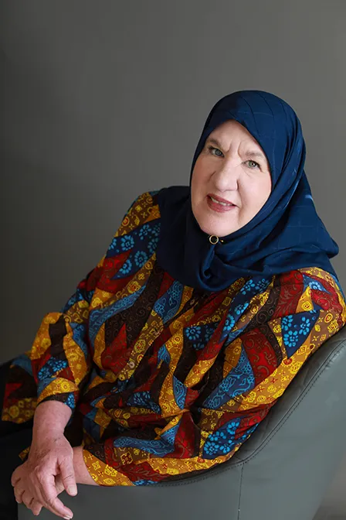
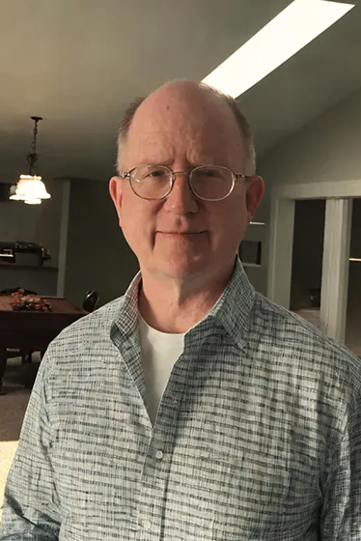
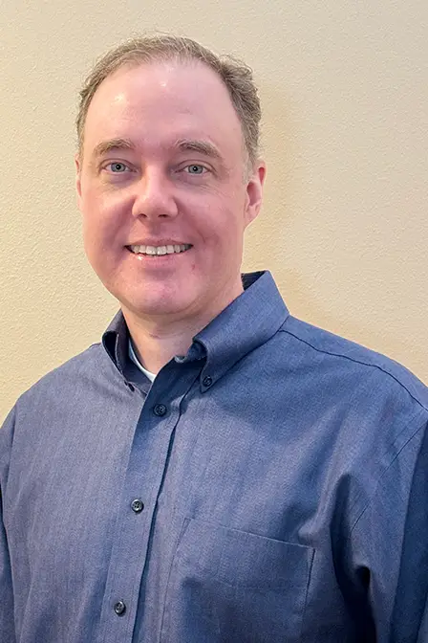
Keynote Speakers
Karen Ghavam
LunarG
Pete Shirley
Activision
John Burgess
NVIDIA
Our three keynote presentations bridge the gap between traditional
high-performance graphics and cutting-edge AI

Slide 10
Special Sessions
Hot3D Sessions
Poster Session
Sponsor Session
Student Competition
Town Hall
Conference Banquet
Awards & Wrap-Up

Slide 11
Special Sessions
Hot3D Sessions
Poster Session
Sponsor Session
Student Competition
Town Hall
Conference Banquet
Awards & Wrap-Up
SIGGRAPH 2024 Panel – High-Performance Graphics 2024 Conference
Thursday, 01 August
3:45 PM – 5:15 PM
Location: Mile High 1A

Slide 12
Hot3D Sessions
Session 1 – Products
Session 2 – Standards
Aleksandra Krstic, Qualcomm
Edward Liu, NVIDIA
Day 1, 11:00 AM – 12:00 PM
Max Oberberger, AMD
Jefferson Amstutz, NVIDIA
Day 2, 3:15 PM – 4:15 PM

Slide 13
Poster Session
Work Graph based Denoising for Real-Time Ray Tracing, Kawala et al.
Hybrid Voxel Formats for Efficient Ray Tracing, Arbore et al.
Real-Time Multi-Gigapixel Light Field Ray Traced Rendering with JPEG Compression, Wells & Hamilton
Fast Local Neural Regression for Low-Cost Global Illumination Denoising, Salmi et al.
Spectral Monte Carlo Denoiser, Noizet et al.
Day 1, 10:30 AM – 11:00 AM
(during the coffee break)

Slide 14
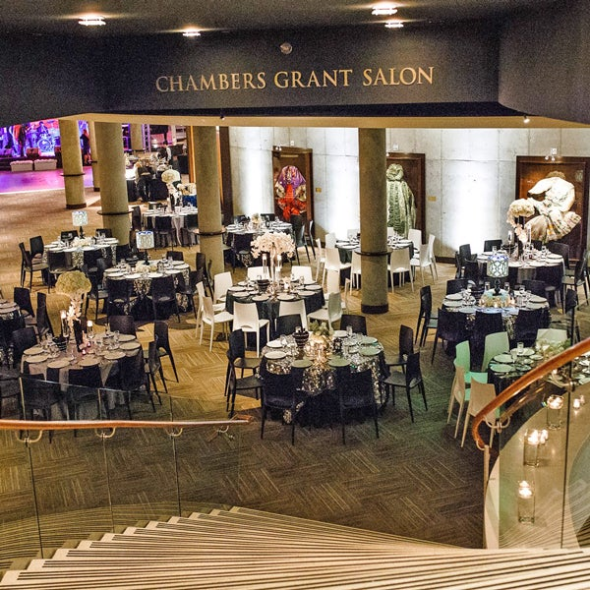
Conference Banquet
Chambers Grant Salon
Anticipated timeline
Drinks & hors d’oeuvres | 6:30 PM
Dinner buffet | 7:30 PM
Closing | 11:00 PM

Slide 15
HPG 2024 Committee
Program Chairs
Papers Chairs
Jacob Haydel, Univ. of Utah
Online Chair
Francois Demoullin, Apple
Registrars
Gaurav Bhokare, Univ. of Utah
Pengpei Hong, Univ. of Utah
Treasurers
Steve Molnar, NVIDIA (advisory)
Esteban Clua, Univ. Federal Fluminense
Richard Membarth, THI and DFKI
Jacco Bikker, Traverse Research
Aaron Knoll, AMD
Posters Chairs
Johannes Meng, Intel
Andrew Kensler, AMD
Sponsorship Chair
Kenny Gruchalla, NREL
Web Site Maintainers
Matthäus Chajdas, Intel
Joshua Steinhurst, Intel
Publicity Chair
Daqi Lin, NVIDIA
Student Competition Chairs
Anjul Patney, NVIDIA
Nicholas Vining, NVIDIA
Hot3D Chair
Won-Jong Lee, AMD
Local Chair
Andrew Garrard, Imagination Tech.

Slide 16
Enjoy the conference!

